Slide 1
Module 4: Error Handling

Slide 3
Agenda
Error Output
Event Handler
Transactions
Checkpoints

Slide 4
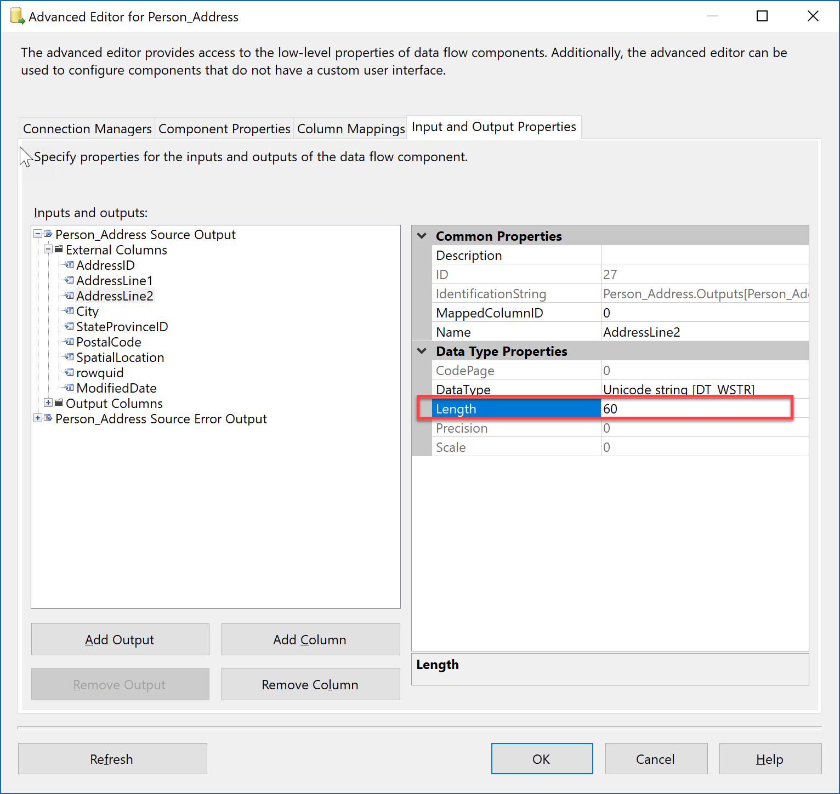
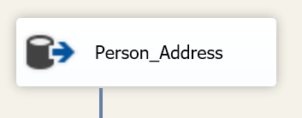
Types of Error within Data Flow
Truncation – Data Source Column value is bigger SSIS Column data type and size defined in “Input and Output Properties” (via Show Advanced Editor)– leading to source value being truncated.
Error – All other errors excluding Truncation Error

Slide 5
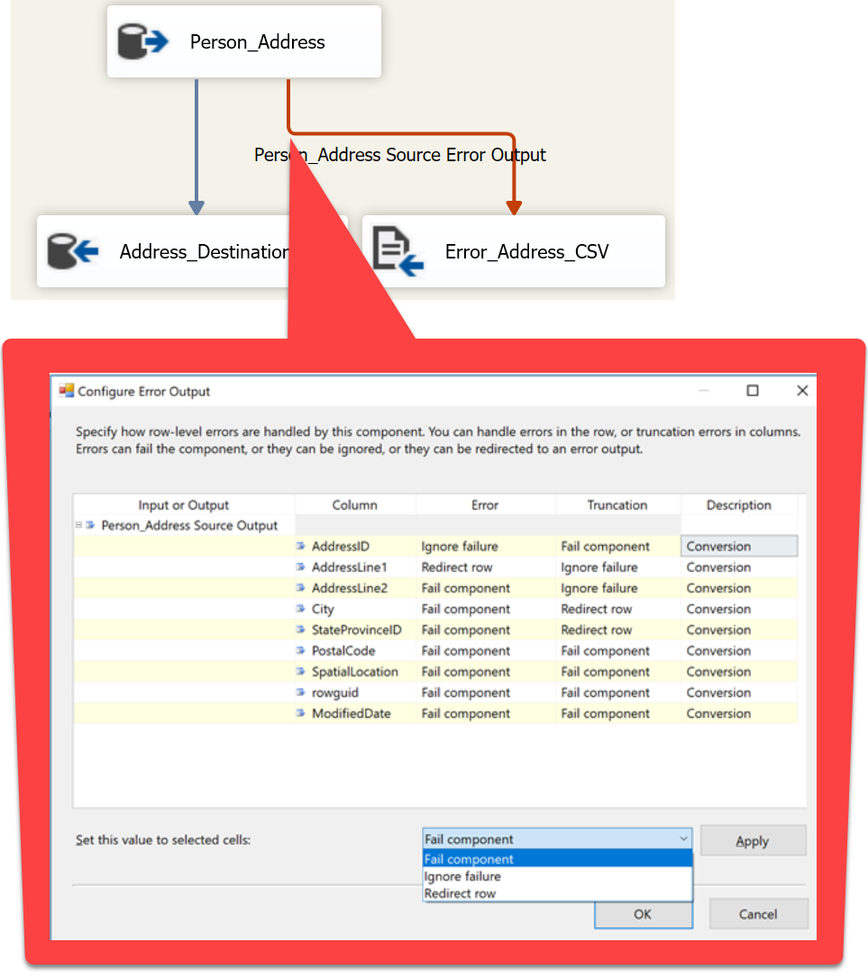
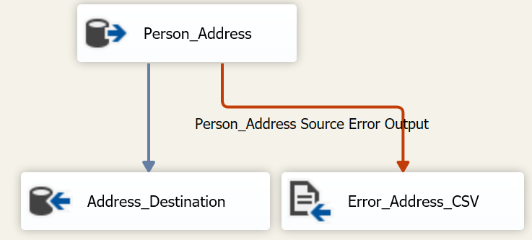
Error Outputs within Data Flow
Determine how to handle errors for columns in Data Flow
Three Options
Fail component (default setting) (e.g., in example, this setting will cause Data Flow Task to fail)
Ignore Failure
Redirect Row

Slide 6
Error Handling
Lab 1

Slide 7
Event Handler
At run time, executables (packages and Foreach Loop, For Loop, Sequence, and task host containers) raise events.
e.g., OnError event is raised when an error occurs.
Control flow canvas available for each event handler.
e.g., perform cleanup operation when error occurs or send email notifications.
Notes:
https://docs.microsoft.com/en-us/sql/integration-services/integration-services-ssis-event-handlers?view=sql-server-2017

Slide 8
Types of Event Handler
Event Handler | Event
OnPreExecute | This event is raised by an executable immediately before it runs.
OnPreValidate | This event is raised by an executable when its validation starts.
OnPostValidate | This event is raised by an executable when its validation is finished.
OnInformation | This event is raised during the validation and execution of an executable to report information. This event conveys information only, no errors or warnings.
OnWarning | This event is raised by an executable when a warning occurs.
OnError | This event is raised by an executable when an error occurs.
OnQueryCancel | This event is raised by an executable to determine whether it should stop running.
OnTaskFailed | This event is raised by a task when it fails.
OnExecStatusChanged | This event is raised by an executable when its execution status changes.
OnProgress | This event is raised by an executable when measurable progress is made by the executable.
OnVariableValueChanged | This event is raised by an executable when the value of a variable changes only if variable’s RaiseChangedEvent property=True;
OnPostExecute | This event is raised by an executable immediately after it has finished running.
Notes:
https://docs.microsoft.com/en-us/sql/integration-services/integration-services-ssis-event-handlers?view=sql-server-2017
OnTaskFailed - This event is raised by a task when it fails.
Can have errors and task succeeds, then this event is not fired.
Eg:
Dts.Events.FireError(0, null, "Custom Error Message", null, 0);
Dts.TaskResult = (int)ScriptResults. Success;
Can have errors and task Fails, then this event is fired.
Eg:
Dts.Events.FireError(0, null, "Custom Error Message", null, 0);
Dts.TaskResult = (int)ScriptResults.Failure;
INSERT INTO EventHandler_Demo (EventName) VALUES (
'OnPreValidate'
)
waitfor delay '00:00:05’
System::SourceName

Slide 9
Event Handler and Container Hierarchy
If an event has no event handler, the event is raised to the next container up the container hierarchy in a package.
If this container has an event handler, the event handler runs in response to the event.
If not, the event is raised to the next container up the container hierarchy.
Notes:
https://docs.microsoft.com/en-us/sql/integration-services/integration-services-ssis-event-handlers?view=sql-server-2017

Slide 10
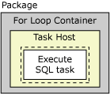
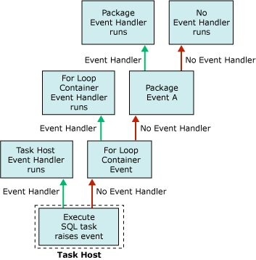
Event Handler and Container Hierarchy (Example)
In following example
Package has Execute SQL Task within For For Loop Container
Package has OnError Event handler defined
Notice: how Events are bubbled up until an Event Handler is found.
Notes:
If an event has no event handler, the event is raised to the next container up the container hierarchy in a package. If this container has an event handler, the event handler runs in response to the event. If not, the event is raised to the next container up the container hierarchy.
https://docs.microsoft.com/en-us/sql/integration-services/integration-services-ssis-event-handlers?view=sql-server-2017

Slide 11
Event Handler
Lab 2

Slide 12
Transactions
Execute tasks as an atomic units
Transaction can be used to rollback when error occurs
Requires distributed transaction coordinator
All container types—packages, the For Loop, Foreach Loop, and Sequence containers, and the task hosts that encapsulate each task—can be configured to use transactions.
TransactionOption Property | Description
Required | Container starts a transaction or joins its parent containers existing transaction.
Supported | Container does not start a transaction, but joins any transaction started by its parent container.
NotSupported | Container does not start a transaction or join an existing transaction
Notes:
https://docs.microsoft.com/en-us/sql/integration-services/integration-services-transactions?view=sql-server-2017

Slide 13
Inherited Transactions
Child package can inherit the parent package transaction if following are met:
Parent Package TransactionOption=Required (or Supported and has joined transaction)
Child package is invoked by an Execute Package task
Execute Package task’s TransactionOption=Supported
Notes:
https://docs.microsoft.com/en-us/sql/integration-services/integration-services-transactions?view=sql-server-2017

Slide 14
Transaction Nesting
Inner transactions are not rolled back as result of outer transaction failure. Careful, might care unintended behavior.
Nested transaction scan be creating by adjusting the TransactionOption property.
For example:
Package Property set to Required.
Container Property set to Not Supported.
Task Property set to Supported.
Notes:
The package property will force a new transaction to be created for the entire package.
However, since a child container does not support transitions but the task in the container does. It will create a new transaction – it cannot join the package transaction.
Now Task transaction is intendent of package.

Slide 15
Restart Packages using Checkpoints
Restart failed packages from the point of failure, instead of rerunning the whole package.
Package execution is written to a checkpoint file.
When the failed package is rerun, the checkpoint file is used to restart the package from the point of failure.
If the package runs successfully, the checkpoint file is deleted and recreated on next run.
Checkpoints are not saved for data flow task.
Checkpoints are not saved for container items (For Loop & Foreach Loop).
Notes:
https://docs.microsoft.com/en-us/sql/integration-services/packages/restart-packages-by-using-checkpoints?view=sql-server-2017
SSIS Checkpoints are not honored for For Loop items - SQL Server | Microsoft Learn

Slide 16
Implementing CheckPoints
Package Property | Description
CheckpointFileName | Contain information about the package state, including the current values of variables. Package Level protection does not protect checkpoint files. Can contain sensitive values. Use an operating system access control list (ACL) to secure the location or folder where you store the file Suggestion: @[$Project::CheckpointPath] +@[System::PackageName] + "_SSIS_.CHK" or @[$Project::CheckpointPath] +@[System::PackageName] + "_SSIS_Checkpoint.xml"
CheckpointUsage =IfExists | IfExists means If the checkpoint file exists, the package restarts from the point of the previous execution failure; otherwise, it runs from the start of the package workflow.
SaveCheckpoints = True | Indicates whether the package saves checkpoints. This property must be set to True to restart a package from a point of failure.
Task Property | Description
FailPackageOnFailure =True | Indicate package fails when executable task fails. Also used to identify restart points if checkpoints are used. Must be set to use checkpoints.
FailParentOnFailure = False | This value should be set to true for containers, such as a sequence.
Notes:
https://docs.Microsoft.com/en-us/sql/integration-services/packages/restart-packages-by-using-checkpoints?view=sql-server-2017

Slide 17
Transactions and Checkpoints
Lab 3

